Slide 1
Nucleic acids part-I
Structure and function of DNA
Dr. Ashok Kumar Yadav
Assistant Professor
Centre for Molecular Biology
Central University of Jammu

Slide 2
Content
What are the Nucleic acids?
Types of Nucleic acids
Different types of nitrogenous bases
Polymerization of nucleotides
Watson-Crick base pairing
DNA structure
Different forms of DNA

Slide 3
Nucleic Acids
Friedrich Miescher (1869) isolated nuclein from the nuclei of pus cells. Nuclein was shown to have acidic properties, hence it became called nucleic acid.
Complex organic biomolecules present in the living cells. The ability to store and transmit genetic information from one generation to the next is a fundamental condition for life.
Nucleic acid is chemical basis of heredity and may be regarded as the reserve bank of genetic information

Slide 4
Types of Nucleic acids
Ribonucleic acids
Deoxyribonucleic acid
Nucleotides are the structure unit of nucleic acids.
Nucleotides composed of 3 components:
Nitrogenous base (Adenine, Cytosine, Guanine, Thymine or Uracil )
Pentose sugar
Phosphate

Slide 5
Types of Nucleic acids
Two types of nucleic acids:
Deoxyribonucleic acid (DNA)
Pentose Sugar is deoxyribose (no OH at 2’ position)
Bases are Purines (A, G) and Pyrimidine (C, T)

Slide 6
Types of Nucleic acids
Ribonucleic acid (RNA)
Pentose Sugar is Ribose.
Bases are Purines (A, G) Pyrimidines (C, U)

Slide 7
Deoxyribonucleic acid (DNA) is exclusively responsible for maintaining the identity of different species of organism. Every aspect of cellular function is under control of DNA.
Gene: A segment of a DNA molecule that contains the fundamental units of genetic information.
Nitrogenous bases
There are 2 types:
Pyrimidines: Single ring structure
Cytosine (C)
Thymine (T)
Uracil (U).
Purines: Two ring structure
Adenine (A)
Guanine (G)

Slide 8
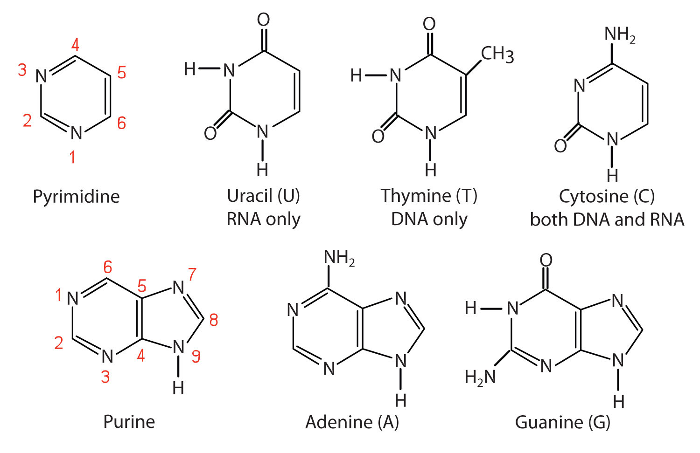
Nitrogenous bases

Slide 9
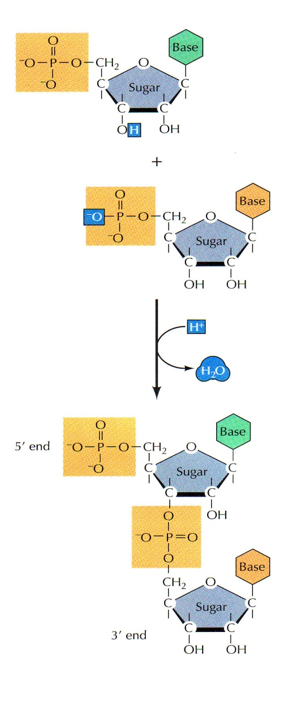
Polymerization of Nucleotides
Nucleic acids are formed of nucleotide polymers.
Nucleotides polymerize together by phospho-diester bonds via condensation reaction.
The phospho-diester bond is formed between:
Hydroxyl (OH) group of the sugar of one nucleotide
Phosphate group of other nucleotide

Slide 10
Polymerization of Nucleotides
The bases are linked to the pentose sugar to form Nucleoside.
Nucleotide = Nucleoside + Phosphate group
The nucleotides contain one phosphate group linked to the 5’ carbon of the one nucleotide and 3’ hydroxyl group of another nucleotide..
Polynucleotide chains are always synthesized in the 5’ to 3’ direction, with a free nucleotide being added to the 3’ OH group of a growing chain.

Slide 11
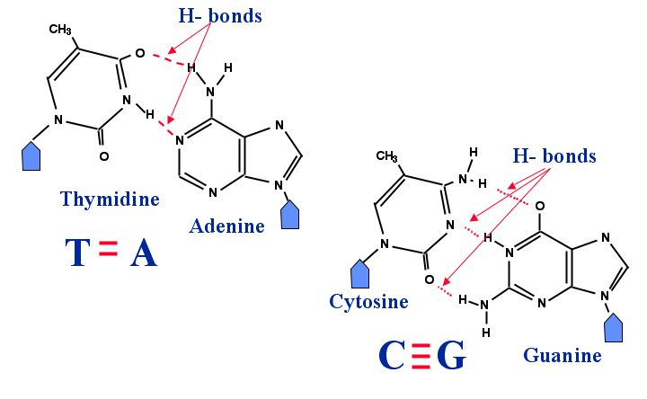
Complementary base pairing
Bases of one polynucleotide chain are complementary with bases of other polynucleotide chain.
Complementary bases are bonded together via hydrogen bond:
DNA : (A═T ) RNA : (A═T or A═U)
DNA : (G≡C) RNA : (G≡C)
Watson-Crick base pairing

Slide 12
DNA structure
DNA is a double stranded molecule consists of two polynucleotide chains running in opposite directions.
The base pairing is very specific which make the 2 strands complementary to each other.
The bases are on the inside of the molecules and the two chains are joined together by double H-bond between A and T and triple H-bond between C and G.
Each strand contain all the required information for synthesis (replication) of a new copy to its complementary strand and direct the synthesis of specific proteins which control most cellular activities.

Slide 13
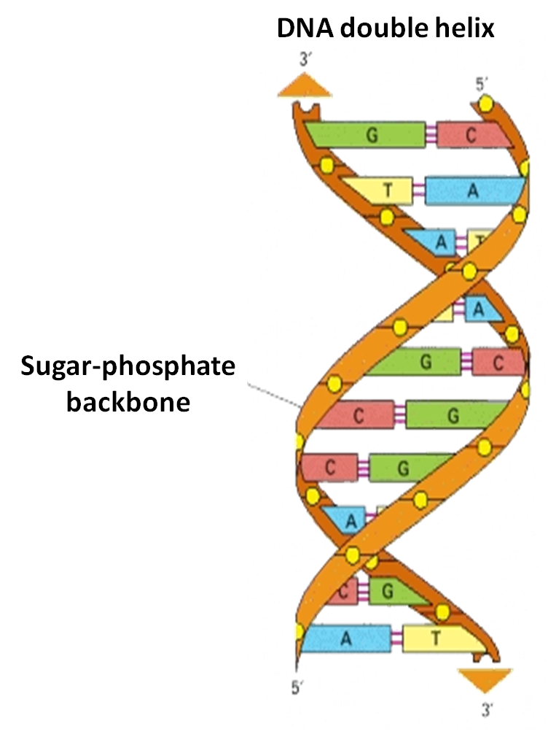
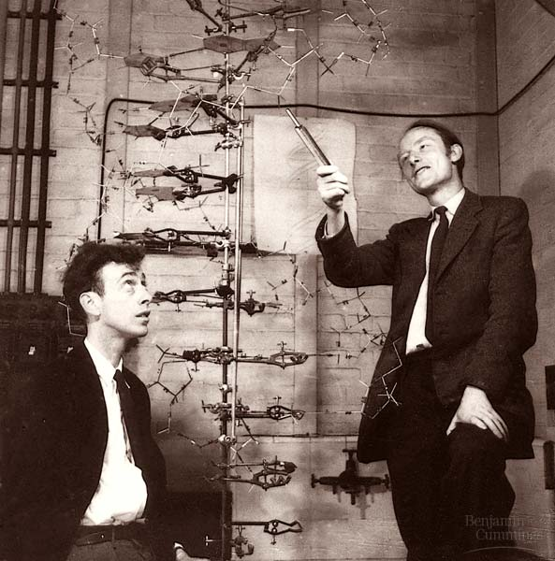
The Double Helix (1953)
James Watson and Francis Crick: Discovered the double-helix structure of DNA, which formed the basis for modern biotechnology.
Public Domain image

Slide 14
Different forms of DNA

Slide 15
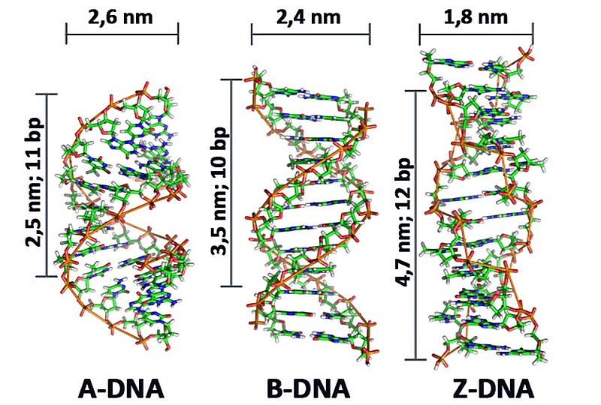
Different forms of DNA

Slide 16
Thank you

