Slide 1
Job Analysis (Pay System Technique for Internal Alignment)
Course Name | Compensation and Reward ManagementLaw
Course Code | PGHRM3E007TRM2C005T
Course In Charge | Anjali Pathania

Slide 2
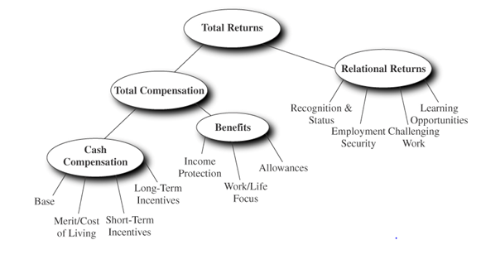
Total Returns from Pay
Source: Milkovich, Newman, Ratnam(2013). Compensation. Mc Graw Hill.

Slide 3
Compensation’s Components
Compensation is a systematic approach to providing monetary and non monetary value to employees in exchange for work performed.
Components:
-Direct compensation in the form of wages or salary
Base pay (hourly, weekly, and monthly)
Incentives (sales bonuses and or commissions)
-Indirect compensation in the form of benefits
Legally required benefits (e.g., Social Security)
Optional (e.g., group health benefits)

Slide 4
Pay Model
Source: Milkovich, Newman, Ratnam(2013). Compensation. Mc Graw Hill.

Slide 5
Job Analysis: Technique for Internal Alignment

Slide 6
General Types
Task Oriented
Person Oriented

Slide 9
USES OF JOB ANALYSIS
Job Evaluation
Wage Setting
Hiring
Clarification of Job Duties and Responsibilities
Transfers and Promotions
Training Need Identification etc.

Slide 10
JOB ANALYSIS METHODS
Questionnaire Method
Check List Method
Individual Interview Method
Observation Interview Method
Group Interview Method
Technical Conference Method
Diary Method
Work Participation Method
Critical Incident Method

Slide 11
Process of Job Analysis
Step 1: Determine the scope of the job analysis in accordance with the department’s requirements, goals, and resources.
Step 2: Determine the procedures to be used for the job analysis.
Step 3: Draft preliminary Task and KSAPC statements
Step 4: Identify subject matter experts (SMEs)
Step 5: Conduct job audits
Step 6: Edit previously drafted Task and KSAPC statements
Step 7: Finalize Task and KSAPC statements
Step 8: Organize the task and KSAPC statements into logical content area or domains.
Step 9: Obtain SME ratings regarding task and KSAPC statements
Step 10: Link critical Task and KSAPC statements and instruct SMEs to come to a consensus on which individual KSAPCs can be linked to one or more tasks.
Step 11: Select employment selection method(s)
Step 12: Create an examination outline
Step 13: Write a job analysis report

Slide 12
To develop a list of tasks, you will want to collect data from a variety of sources, including archival information (e.g., job descriptions, duty statements etc.), job audits , observations, workshops (e.g., brainstorming sessions) and so forth.
TASKS
Each statement should be a clear recitation of a work activity, and should be comprised of five elements:
1. Action verb
2. Object of the verb
3. Rationale or observable work product
4. Materials, tools, procedures, or equipment used
5. Under what direction or guidelines
KSAPC
1. What is it? Knowledge of, Skill to, or Ability to?

Slide 13
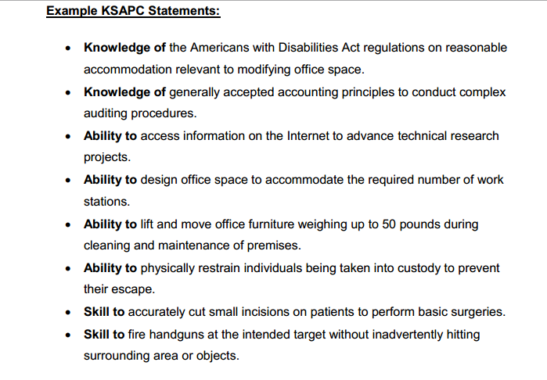

Slide 14
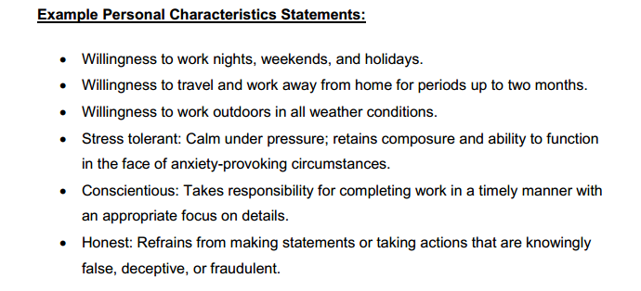

Slide 15
“Typical” Job Analysis Process
Develop Task Statements
Develop KSA Statements
Rate Task & KSA Statements
Connect Tasks & KSAs

Slide 16
Task Rating Form
A B C D E
 | Task description | Frequency of use 5 = almost all of the time 4 = frequently 3 = occasionally 2 = seldom 1 = not performed at all | Importance of performing successfully 5 = extremely important 4 = very important 3 = moderately important 2 = slightly important 1 = of no importance | Importance for new hire 5 = extremely important 4 = very important 3 = moderately important 2 = slightly important 1 = of no importance | Distinguishes between superior & ad. performance 5 = a great deal 4 = considerably 3 = moderately 2 = slightly 1 = not at all | Damage if error occurs 5 = extreme damage 4 = considerable damage 3 = moderate damage 2 = very little damage 1 = virtually no damage
1
2
3
4
5
6
7
8

Slide 17
KSA Rating Form
 | KSAO | Importance for acceptable job performance 5 = extremely important 4 = very important 3 = moderately important 2 = slightly important 1 = of no importance | Importance for new hire 5 = extremely important 4 = very important 3 = moderately important 2 = slightly important 1 = of no importance | Distinguishes between superior & adequate performance 5 = a great deal 4 = considerably 3 = moderately 2 = slightly 1 = not at all
A
B
C
D
E
F
G
H

Slide 18
TASK -- KSA MATRIX
To what extent is each KSA needed when performing each job task?
5 = Extremely necessary, the job task cannot be performed without the KSA
4 = Very necessary, the KSA is very helpful when performing the job task
3 = Moderately necessary, the KSA is moderately helpful when performing the job task
2 = Slightly necessary, the KSA is slightly helpful when performing the job task
1 = Not necessary, the KSA is not used when performing the job task
KSA | A | B | C | D | E | F | G | H | I | J | K | L | M | N | O | P | Q | R
Job Tasks
1
2
3
4
5
6
7
8

Slide 19
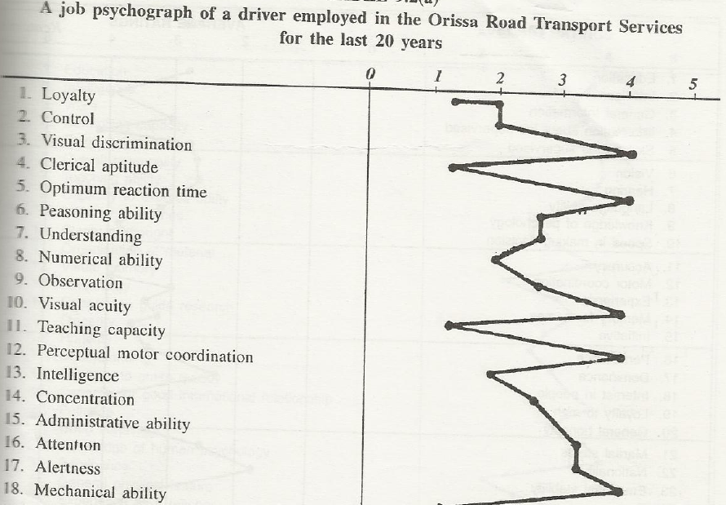

Slide 20
THANK YOU

