Slide 1
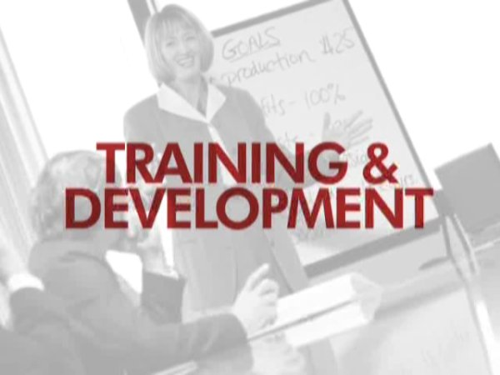
TRAINING ANDDEVELOPMENT
MHRM-402

Slide 2
Types of Training
Orientation training
Job Instruction Training (JIT)
Refresher training
Vestibule training

Slide 3
DESIGNING A TRAINING PROGRAMME
The training is an integral part of an organization. To enhance the knowledge and skills of employees, an organization has to develop an appropriate and suitable method of training. A training programme involves the following steps.
Identification of training needs.
Establishing training objectives.
Developing a training programme.
Evaluation of training programme.

Slide 4
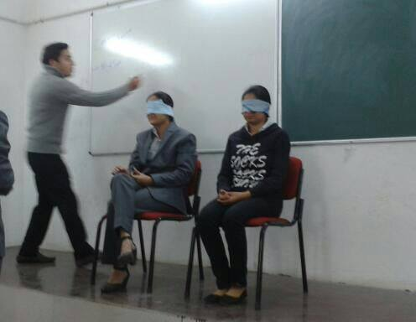
THE TRAINEES ARE MAINLY TRAINED THROUGH THE FOLLOWING METHODS
Lecture methods
Case study
Audio visual aids
Assignments & projects
Management games like simulation etc.

Slide 5
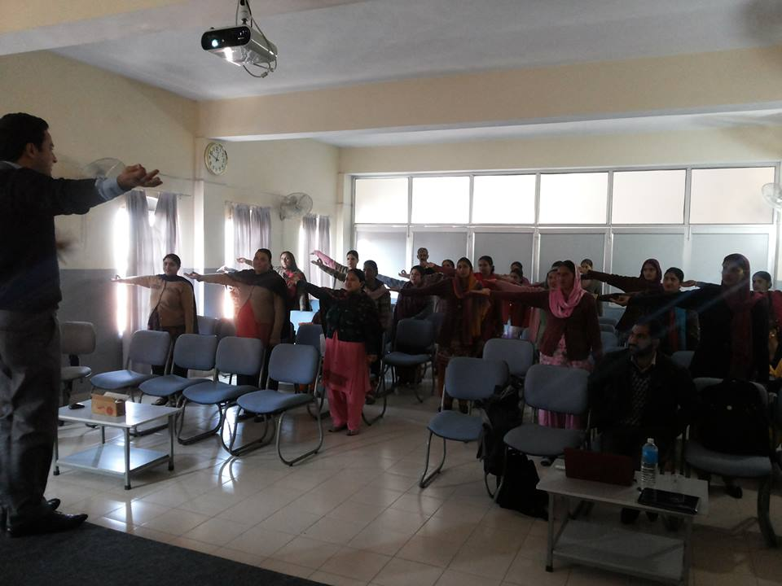
DEVELOPMENT PROGRAMMES
On- the- job experience
Coaching
Understudy:
Job rotation
Special courses
Special meetings
Special projects
Conferences
Lectures
Group discussions

Slide 6
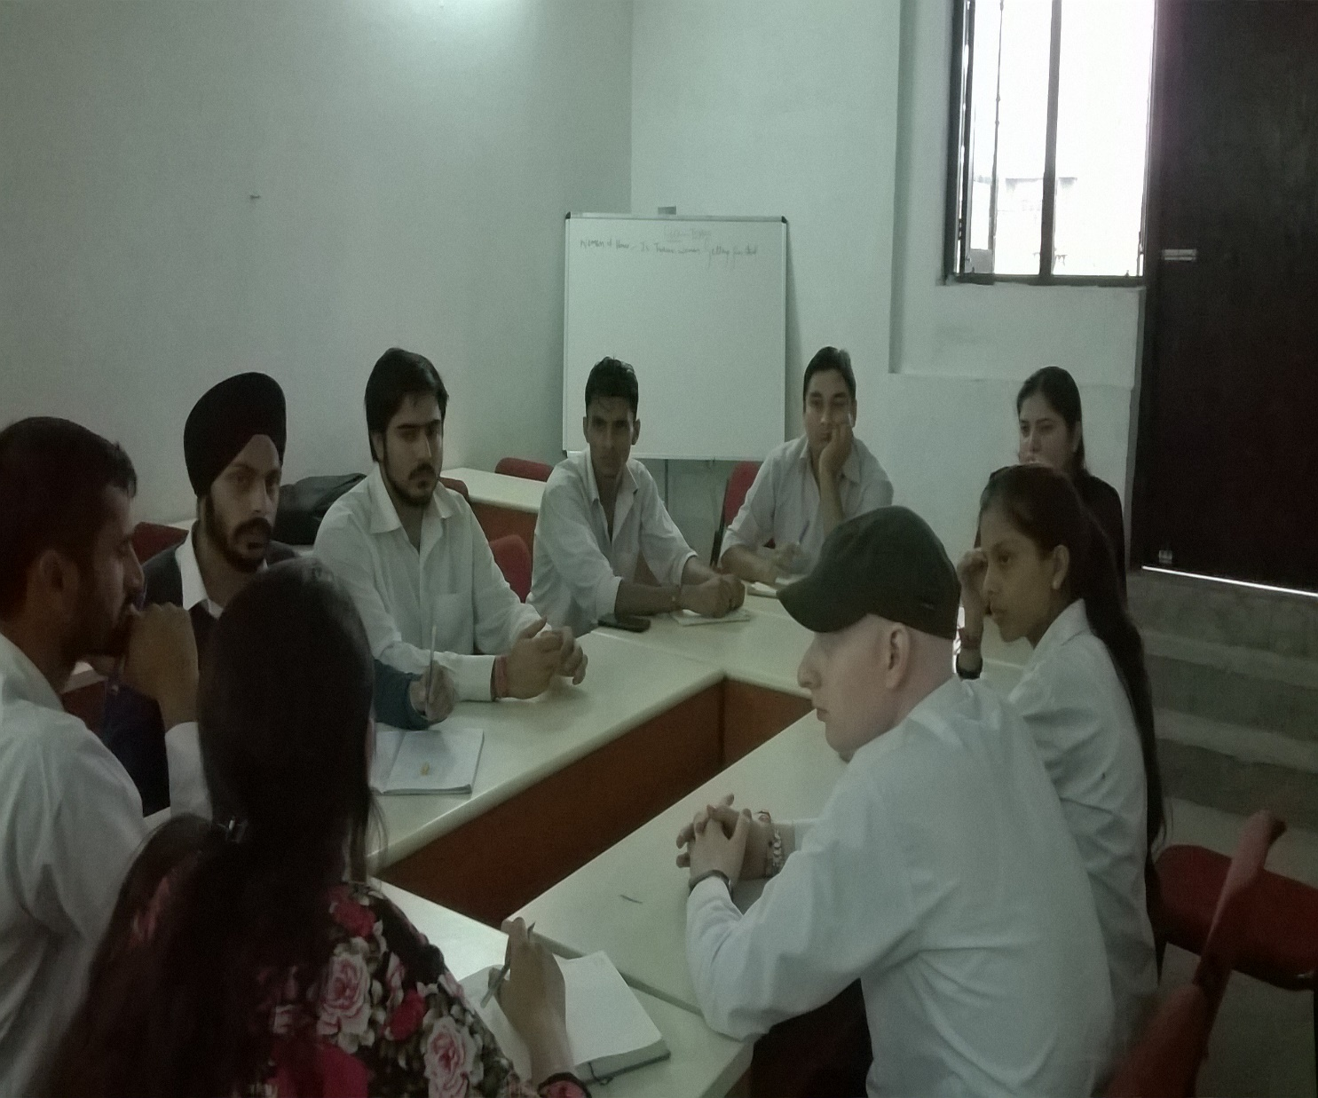
Group discussions

Slide 7
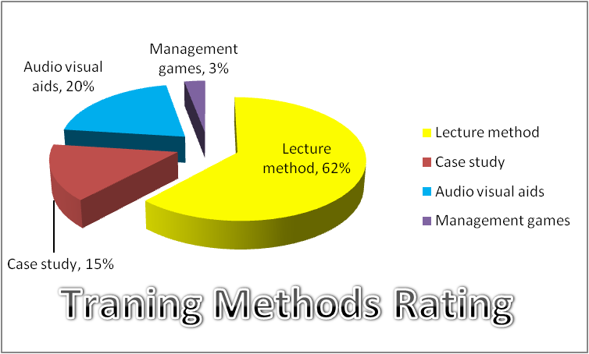

Slide 8
