Slide 1
Human DEvelopment
Rajesh Kumar
Assistant Professor Department of Economics Central University of Jammu

Slide 2
Why Human Development?
Development is analyzed and understood in terms of people. People are moved to centre stage.
It is assumed to be two sides
Formation of capabilities- health, knowledge and skills.
People make of their acquired capabilities- for employment, productive activities, political affairs or leisure.

Slide 3
Essential Components of Human Development
Equity- equitable access to opportunities.
Sustainability- the next generation deserve the opportunity to enjoy the same well being that we enjoy today.
Productivity- to achieve maximum potential.
Empowerment- one must participate in the activities, events and the processes that shape their lives.

Slide 4
Continued……
It is recognized the people are both means and end of development. Since it always remembered the human beings are the ultimate end of development.

Slide 5
Human Development
A standard definition of human development (1990 HDR):
“[…] a process of enlarging people’s choices to live lives they have reason to value… The most critical ones are to lead a long and healthy life, to be knowledgeable and to enjoy a decent standard of living.”
A broader definition (2010 HDR):
“Human development is the expansion of people’s freedoms to live long, healthy and creative lives; to advance other goals they have reason to value; and to engage actively in shaping development equitably and sustainably on a shared planet”

Slide 6
Human Development Index
Emphasizes that outcomes for people and their capabilities should be the ultimate criteria for assessing the progress of a country, not economic growth alone.
Accounts for average achievements in
life expectancy (proxy for leading a long and healthy life),
education (proxy for being knowledgeable) and
income per capita (proxy for command over resources to have a decent standard of living).

Slide 7
HUMAN DEVELOPMENT INDEX
A simple index (non-comprehensive) with the purpose of
initiating discussions
attracting attention to issues that prevent countries from performing at a higher level
international comparison and benchmarking
temporal comparison

Slide 8
General Criteria for a Good HDI
(I) Corresponds to strong policy and advocacy needs
Understandable and easy to describe
Understandable at a deeper level including goalposts and group-cutoffs
Measuring absolute “size of HD” - independent from other countries
Conforms to a notion of what is being measured
Anchored in underlying variables
Numbers mean something
(II) Concerns the intended purpose of the index
It must fit the purpose for which it is being developed
Complements GDP or/and GNI
Compares HD achievements across countries
- Monitors progress across time for a given country
- Analytical utility (subgroups or dimensions)

Slide 9
CONTINUED……..
(III) Theoretically justified
Technically solid
Axioms to make sure that index’s properties conforms to purpose
Theoretical framework (within human capabilities approach and/or welfare economics)
(IV) Practicality
Operationally viable and easily replicable
- Works with existing data for all the countries and all the years
- It can be updated in time

Slide 10
Calculation of HDI from Dimension Index
Calculation of Dimension Index=
Actual Value-Minimum Value/Maximum-Minimum Value
An Aggregate of these sub indices is obtain in terms of their geometric mean as follows:
HDI=

Slide 12
How to decide about goalposts $(m_{x},M_{x})$?
Purely data drivengoalposts cause confusion
Ought to have firm normative basis
Different purpose of goalposts:
Upper (aspiration level)
may change periodically but infrequently, 5 – 10 years, normative targets
- In a constrained way (or proportionate)
- All past inconsistencies will then be caused by data revisions
Lower (natural zeros) should stay fixed
Properties of the index should not be compromised
- Equal implicit weights (by making the range of variation very similar)

Slide 13
HOW TO DECIDE ABOUT DEMARCATION CUT-OFFS FOR CATEGORIZING COUNTRIES INTO DIFFERENT LEVELS OF HD?
Fix absolute demarcation cut-offs for categorizing countries
Choose relatively, then fix absolutely, or
Look within variables for natural cut-offs
Cut-offs are always arbitrary
- Like poverty lines, like middle class ranges
But if fixed over time, countries can progress
Consistent cut-offs can be maintained over time

Slide 14
Dimension of Human Development

Slide 15
Construction of HDI
Dimensions | Long and Healthy Life | Knowledge | A Decent Standard of Living
Indicator | Life Expectancy at Birth | Expected Year of Schooling Mean Year of Schooling | Gross National Income (PPP$)
Dimension Index | Life Expectancy Index | Education Index | GNI Index

Slide 16
Changes in the HDI introduced in 2010
GOAL POSTS
Minima: Fixed at “natural zeros” | Maxima: Observed maxima since 1980 | Comments: A possible change of maxima every year; HDI level of India depends on Life Expectancy of Japan, education in and Gross National Income of Qatar

Slide 17
GOAL POSTS FOR CALCULATING THE HDI 2014
Dimension | Indicator | Minimum | Maximum
Health | Life Expectancy (years) | 20 | 85
Education | Expected year of Schooling Mean Year of Schooling | 0 0 | 18 15
Standard of Living | Gross National Income(PPP $) | 100 | 75000

Slide 18
CONTINUED….
Example : In case of India (2013)
Life Expectancy = 66.4 Years
Expected Year of Schooling= 11.7
Mean Year of Schooling= 4.4
Gross National Income = $5150( 2011,PPP $)

Slide 19
Continued……….
Life Expectancy Index=66.4-20/85-0= 0.714
Mean year of Schooling= 4.4-0/15-0=0.293
Expected year of Schooling= 11.7-0/18-0=0.650
Education Index= 0.293+ 0.650/2=0.4715
Income Index = log5,150-log100/log 75000-log100= 0.595
HDI of India = 0.714x 0.4715x0.595=0.586

Slide 20
New Methodology for Human Development Index

Slide 21
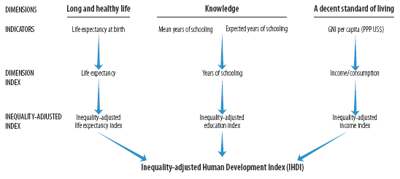
Methodology for Inequality-adjusted Human Development Index (IHDI)

Slide 22
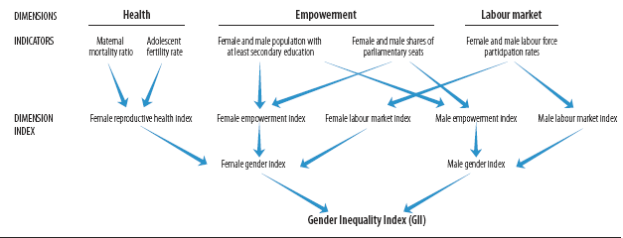
Methodology for Gender Inequality Index

Slide 23
Methodology for Multi-Dimensional Poverty Index

Slide 24
HD Indices Sources
HDI
Life expectancy: UNDESA World Population Prospects
Years of Schooling: UNESCO Institute for Statistics and Barro and Lee (2010) [NBER working paper 15902]
GNI PPP per capita: World Bank’s World Development Indicators
IHDI
Life expectancy: UNDESA World Population Prospects
Years of Schooling: household survey data in international databases (EUSILC, UNICEF-MICS, USAID-DHS, WHO-WHS)
Household income or consumption: household survey data in international databases (Luxemburg Income Study, EUSILC, UNICEF-MICS, USAID-DHS, World Bank’s International Income Distribution Database, United Nations University’s Income Inequality Database)

Slide 25
HD Indices Sources
GII
Maternal Mortality: UNICEF’s The State of World’s Children
Adolescent Fertility: UNDESA World Population Prospects
Educational Attainments: UNESCO Institute for Statistics and Barro and Lee (2010) [NBER working paper 15902]
Labour Market Participation: ILO LABORISTA database
MPI: household surveys
Demographic and Health Survey – USAID
The Multiple Indicators Cluster Survey – UNICEF
The World Health Survey - WHO

Slide 26
Themes of HDR 1990-2015
HDR 90 - CONCEPT AND MEASUREMENT
HDR 91 - FINANCING
HDR 92 - GLOBAL DIMENSIONS
HDR 93 - PEOPLE’S PARTICIPATION
HDR 94 - HUMAN SECURITY
HDR 95 - GENDER
HDR 96 - ECONOMIC GROWTH
HDR 97 - ERADICATE POVERTY
HDR 98 - CONSUMPTION
HDR 99 - GLOBALIZATION
HDR 00 - HUMAN RIGHTS
HDR 01 - NEW TECHNOLOGIES
HDR 02 - DEMOCRACY
HDR 03 – MILLENNIUM DEVELOPMENT GOALS
HDR 04 - CULTURAL LIBERTY
HDR 05 - AID, TRADE AND SECURITY
HDR 06 - WATER
HDR 07/08 - CLIMATE CHANGE
HDR 09 - MIGRATION
HDR 10 - PATHWAYS Human Development
HDR 11 - SUSTAINING EQUITABLE PROGRESS
HDR 13-THE RISE OF THE SOUTH
HDR 14-SUSTAINING HUMAN PROGRESS
HDR 15- WORK FOR HUMAN DEVELOPMENT

Slide 27
References
Haq ul Mehbub(1995) “Reflections on Human Development,” Oxford University Press.
UNDP Reports 1990-2015
http://hdr.undp.org/en
National Human Development Reports

