Slide 1
Comparative advantage theory of international trade

Slide 2
Classical Theory of International Trade
Supply Version of Classical theory of International Trade
Adam Smith: Theory of Absolute Cost Advantage
David Ricardo: Theory of Comparative Cost Advantage

Slide 3
ABSOLUTE ADVENTAGE THEORY OF INTERNATIONAL trade
Trade between two nations is based on absolute advantage. If
X_{A} > X_{B} (Efficient in A Good)
^{Y}_{A} ^{< Y}_{B} _{(Efficient in B Good)}
Where X and Y stands for nation and A and B stands for goods.
When one nation is more efficient than other nation in the production of one commodity but less efficient than the other nation in other line of production and both nations can gain by each specialization in the production of its absolute advantage and exchanging part of its output with the other nation for the commodity of its absolute disadvantage.

Slide 4
Comparative advantage theory
David Ricardo argued that what happen to international trade if one nation have absolute advantage in both line of production and other nation have absolute disadvantage in both line of production?
To answer this question in 1817 Ricardo Published his ‘Principles of Political Economy and Taxation’ in which he presented Law of Comparative Advantage.

Slide 5
Law of Comparative Advantage
Law of comparative advantage states that even nation is less efficient than the other nation in the production of both commodities, there is still a basis for mutually beneficial trade. The first nation should specialized in the production of and export the commodity in which its absolute disadvantage is smaller or the opportunity cost of production is lowest and import the commodity in which its absolute disadvantage is greater.

Slide 6
Assumptions of theory
There are only two countries producing two commodities.
Free trade.
Perfect mobility of labour with in each nation but immobility between two nation.
Constant cost of production.
No transportation cost.
No technical change.
The labour theory of value.

Slide 7
Labour cost (Man-Hours) per unit output
Country | Commodity | Commodity
 | 1 unit of wine | 1 unit of cloth
Portugal | 80 | 90
England | 120 | 100

Slide 8
Opportunity cost of production
Opportunity Cost for
Country | Wine | Cloth
Portugal | 80/90 | 90/80
England | 120/100 | 100/120

Slide 9
Continued…………
From the table it is clearly visible that in order to produce one unit of wine in Portugal there is requirement of 80 man-hours and for one unit of cloth production 90 man-hours.
Where as in order to produce one unit of wine in England there is requirement 120 man-hours and for the production of cloth 100 man - hours.
Simply we can analyze that Portugal have comparative advantage in wine production and England have comparative advantage in cloth production.

Slide 10
Continued………
If both nation wants to trade Portugal will start producing only wine (commodity of its comparative advantage) and England will produce cloth commodity (commodity of England's comparative advantage).
Where as before international trade countries are producing a combination of wine and cloth.
When countries open up their economies for international trade they will produce only the good where they have comparative advantage and because of this there is production gain for the country.
The countries will exchange the commodities by this consumption gain for the countries because of international trade.
At the end overall welfare increase in the country.

Slide 11
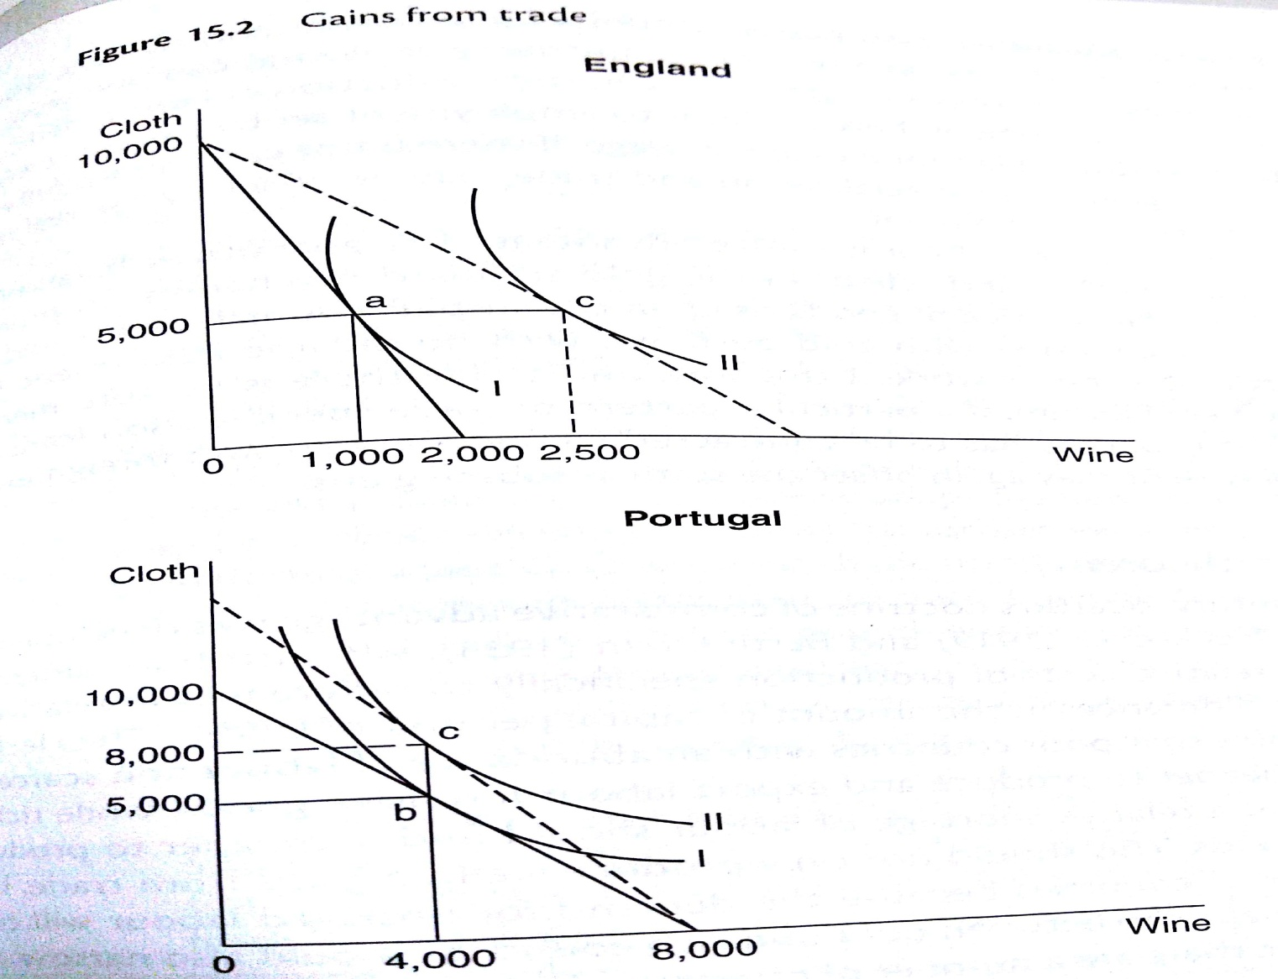
Gain from international trade

Slide 12
Gains from trade
Suppose with the given resources, England can produce 10,000 yards of cloth or 2000 bottles of wine with opportunity cost ratio between cloth and wine is 10:2. Portugal on other hand can produce 10,000 yards of cloth or 8000 bottles of wine with opportunity cost ratio between cloth and wine 10:8.Clearly the opportunity cost of producing wine is less than in England and the opportunity cost of producing cloth in England is lower.
If the international rate of exchange between the two domestic rates of exchange (i.e 10:2 and 10:8) both countries will gain from trade.

Slide 13
Suggested Readings
International Economics by Bo Sodersten
International Economics: Trade and Finance by Dominick Salvatore
International Economics: Sodersten and Reed
Economic of Development by A.P. Thirlwall

