Slide 1

Polymer Science
Department of Nano Science and Materials
Central University of Jammu, Jammu
Dr. Pawan Kumar
Assistant Professor

Slide 2


Slide 3
Definition
The word ‘Polymer’ meaning "many parts “
The term “Polymer" was coined in 1833 by Jöns Jakob Berzelius
Polymer is subfield of materials science
Very large molecules
Many ‘Monomers’ join together to form long chains

Slide 4
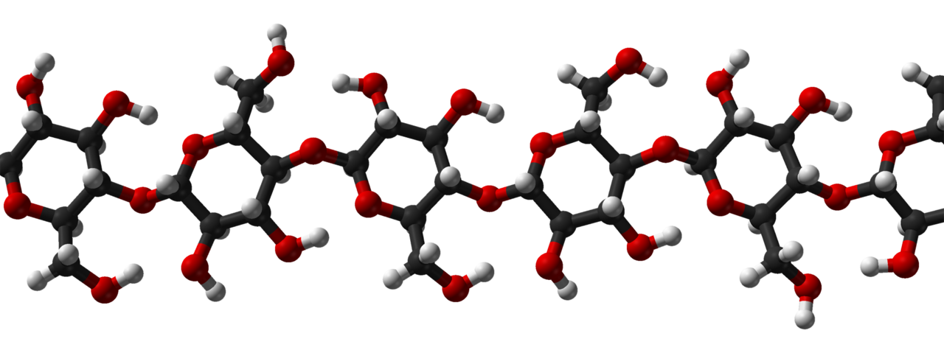
Examples for Polymers
First modern example of polymer science is form Henri Braconnot's work in 1830s
Braconnot along with Christian Schönbein and others co-workers developed natural polymer cellulose derivatives such as celluloid and cellulose acetate
Ref: J. Am. Chem. Soc. 124 (31): 9074–82

Slide 5
Classification of Polymers
Natural and Synthetic Polymers
Organic and Inorganic Polymer
Thermoplastic and Thermosetting Polymer
Plastics, Elastomers, fibers and Liquid Resins or Miscellaneous Polymer
For details information about the each class of polymers, students or readers can refer any text or reference book on polymers science and technology

Slide 6
Synthesis Techniques of Polymers
Due to abundant availability of literature, polymer synthesis is not difficult, Generally synthesis of polymers, we need appropriate quantity of monomer, catalyst, and suitable polymerization reaction including
Chain Polymerization reaction
Free-radical Polymerization
Ionic Polymerization
Coordination Polymerization
Step Polymerization reaction
Polycondensation
Polyaddtion
Ring opening Polymerization
Miscellaneous Polymerization reaction
Electrochemical Polymerization
Metathetical Polymerization
Group Transfer Polymerization

Slide 7
Properties of Polymers
High surface area
Chemical and thermal stability
Functionality selectivity
Interconnectivity and flexibility
Electrical Conductivity
Luminescent Nature
Non-toxic
Biodegradability
Regenerative
Environmental safe
* Above mention properties are entitled for specific class of polymers

Slide 8
Applications
Gas storage
Catalysis
Ion exchange
Adsorption
Sensing – Chemical, Electrochemical, Fluorescence
Drug delivery
Molecular separations
Molecular recognition

Slide 9
Modern Research and Development
for
Polymers or Coordination Polymers applications

Slide 10
Coordination Polymers or Metal Organic Frameworks (MOFs)
Hybrid inorganic–organic compounds
Coordinating Polymers
Metal Center: metal / metal clusture*
Ligands: luminescent groups, typically conjugated organic compounds, absorb in the UV and visible region.
Some important MOFs in literature
[Zn₄O(bdc)₃] (MOF-5; bdc = 1,4-benzenedicarboxylate)
[Cu₃(btc)₂] (HKUST-1; btc = 1,3,5-benzenetricarboxylate)
[Zn₂(bdc)₂(dabco)] (dabco = 1,4-diazabicyclo[2.2.2]octane),
[Fe(OH)(bdc)] and [Fe₃O(bdc)₃(Ac)] (Ac = CH₃COO)
* ensemble of bound atoms, group of two or more metal atoms where direct and substantial metal-metal bonding is present
Main cluster types are "naked" clusters and those with stabilizing ligands. In transition metal clusters, typical stabilizing ligands include carbon monoxide, halides, isocyanides, alkenes, and hydrides

Slide 11
Motivation Factors (1/2)
Metal organic frameworks (NMOFs) combine the following properties*:
Stable, Luminescent Markers
Host-guest chemistry based molecular detections
Porous Network with Large Surface to Volume Ratio: larger volume for analyte interaction → High sensitivity
Solid-state device compatibility
Interaction with analyte induces changes in luminescence, absorbance, and conductivity → Multimode Signal Transduction
Biofunctionalization → Integrated Chemo + Bio Sensing Systems, Specificity
*in context of the diverse environmental applications
Some other useful properties of NMOFs are pore-selective functionality, High temperature stability,
Low desorption energy, Controlled diffusion of guest moieties

Slide 12
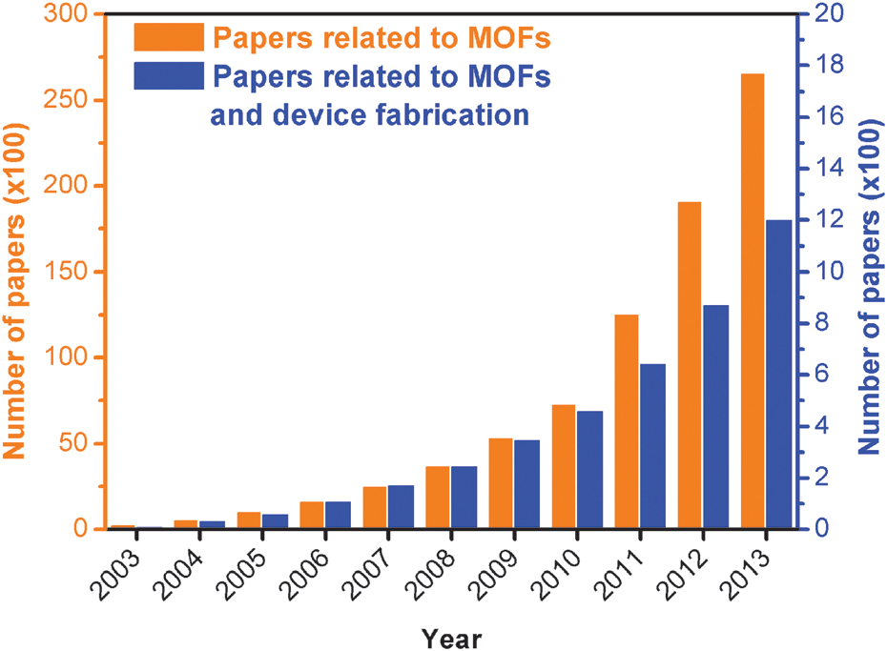
Motivation Factors (1/2)
Evolution of the cumulative number of papers related to metal
organic frameworks (MOFs, orange columns and left Y-axis, 100), and to
MOFs and device fabrication (blue columns and right Y-axis, 100), in the
2003–2013 period. Source: ISI Web of Science

Slide 13
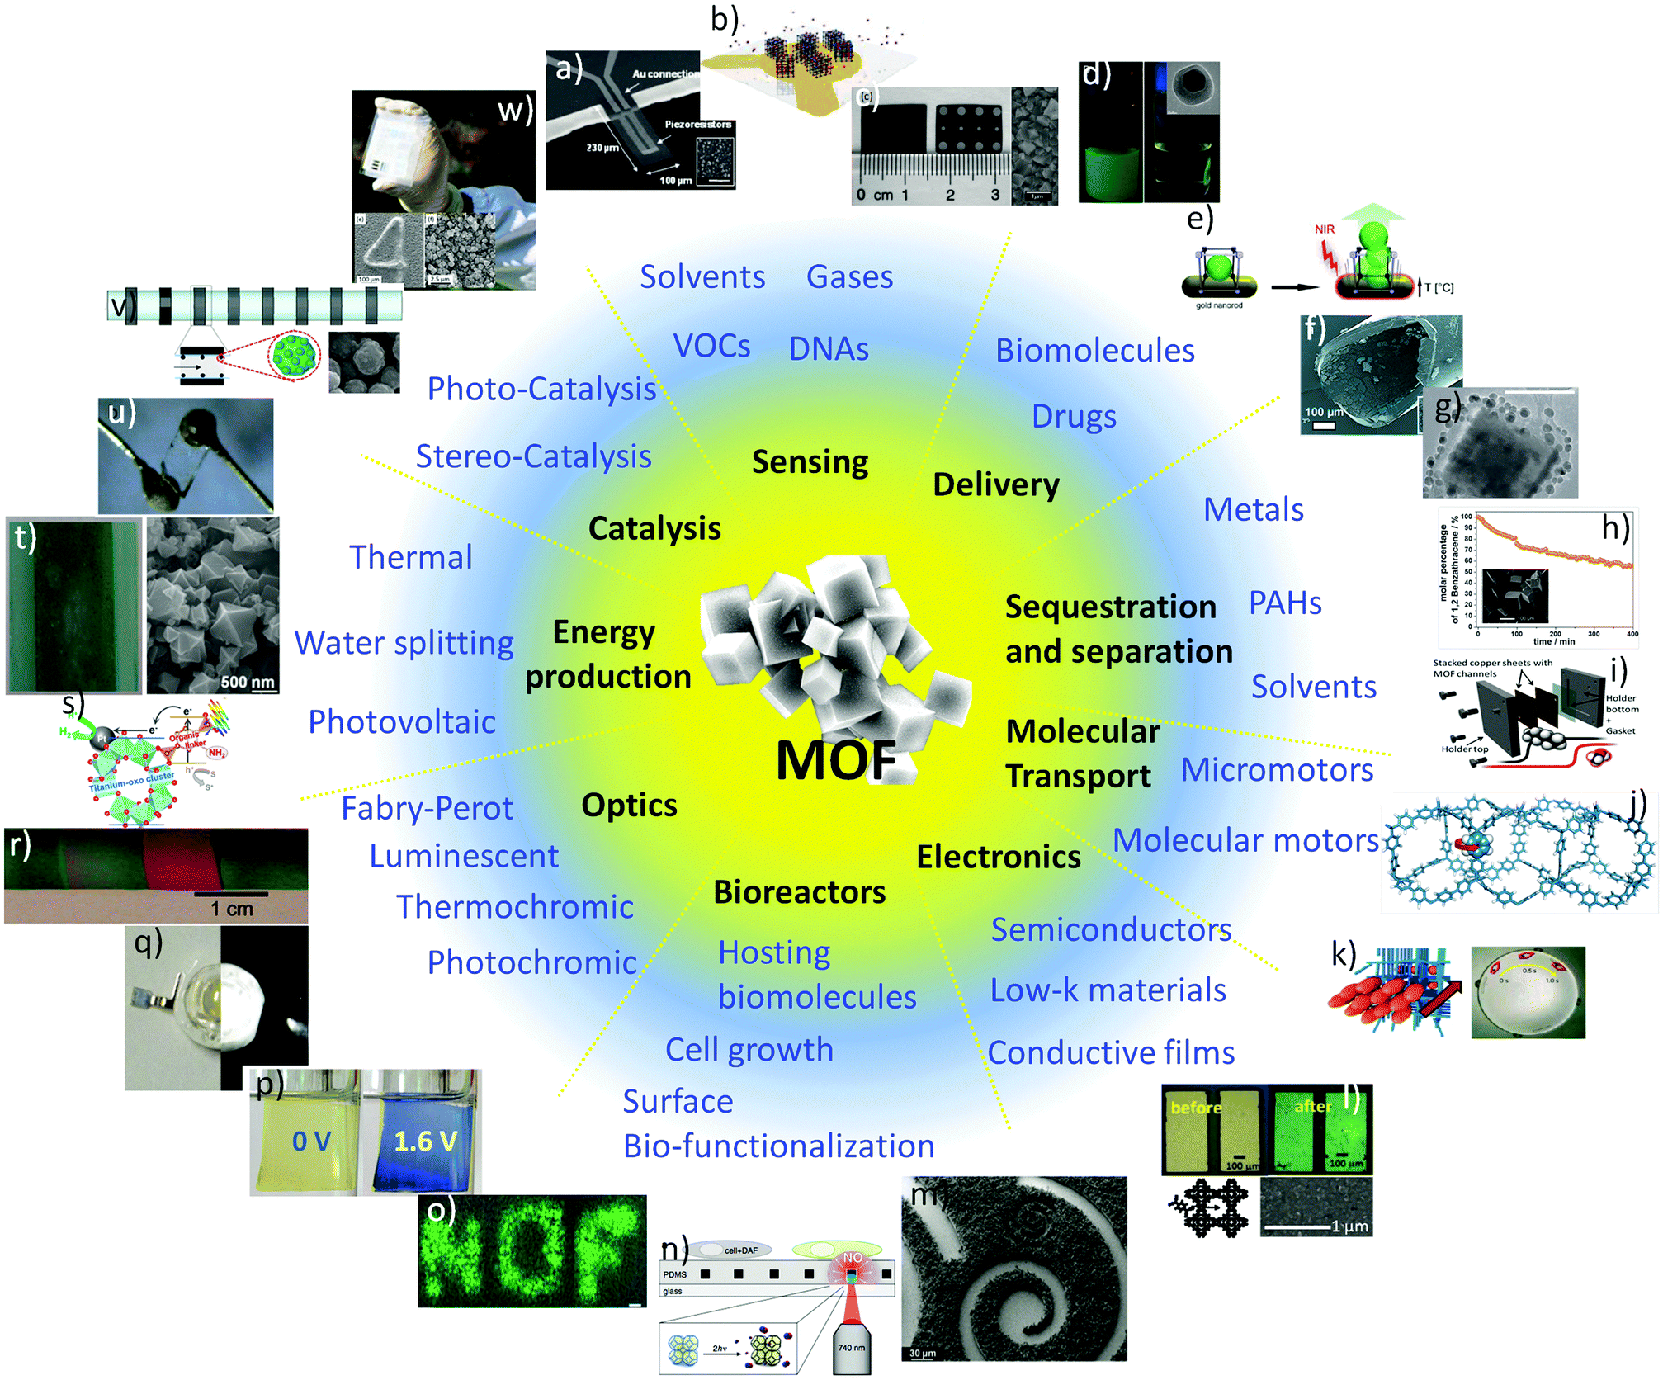
Applications of MOFs
@ Chem. Soc. Rev., 2014, 43, 5513-5560

Slide 14
Major References
U.S.EPA Policy for Managing Risk to Workers from Organophosphate Pesticides (OPs) http://www.epa.gov/opp00001/factsheets/opworkers.htm ((accessed on June 15, 2014).
P. Horcajada, T. Chalati, C. Serre et al., “Porous metal-organic-framework nanoscale carriers as a potential platform for drug delivery and imaging,” Natural Materials, vol. 9, no. 2, pp. 172-178, 2010.
J. Hafizovic, M. Bjørgen, U. Olsbye et al., “The inconsistency in adsorption properties and powder XRD data of MOF-5 is rationalized by framework interpenetration and the presence of organic and inorganic species in the nanocavities,” Journal of the American Chemical Society, vol. 129, no. 12, pp. 3612-3620, 2007.
B. Chen, X. Wang, Q. Zhang et al., “Synthesis and characterization of the interpenetrated MOF-5,” Journal of Materials Chemistry, vol. 20, no. 18, pp. 3758-3767, 2010.
S. Bordiga, C. Lamberti, G. Ricchiardi et al., “Electronic and vibrational properties of a MOF-5 metal-organic framework: ZnO quantum dot behaviour,” Chemical Communications, vol. 20, pp. 2300-2301, 2004.
T. Tachikawa, J. R. Choi, M. Fujitsuka et al., “Photoinduced Charge-Transfer Processes on MOF-5 Nanoparticles: Elucidating Differences between Metal-Organic Frameworks and Semiconductor Metal Oxides,” The Journal of Physical Chemistry C, vol. 112, no. 36, pp. 14090-14101, 2008.
C. Li, C. Wang, Y. Ma et al., “Voltammetric determination of trace amounts of fenitrothion on a novel nano-TiO2 polymer film electrode,” Microchimica Acta, vol. 148, no. 1-2, pp. 27-33, 2004.
X. Liu, “Electrochemical Sensor for Determination of Parathion Based on Electropolymerization Poly (Safranine) Film Electrode,” International Journal of Electrochemistry, vol. 2011, pp. 986494-500, 2012.
M. Muller, S. Hermes, K. KaÌˆhler et al., “Loading of MOF-5 with Cu and ZnO nanoparticles by gas-phase infiltration with organometallic precursors: Properties of Cu/ZnO@ MOF-5 as catalyst for methanol synthesis,” Chemistry of Materials, vol. 20, no. 14, pp. 4576-4587, 2008.
L. Zhang, “Determination of Malathion Based on Carbon Nanotubes Modified Electrode Incorporating Acetylcholinesterase,” Journal of Electrochemistry, vol. 13, no. 04, pp. 431-435, 2007.
G. Liu, and Y. Lin, “Electrochemical stripping analysis of organophosphate pesticides and nerve agents,” Electrochemistry communications, vol. 7, no. 4, pp. 339-343, 2005.
P. Raghu, M. R. M. Reddy, T. M. Reddy et al., “Detection of Organophosphorous Pesticides Using a Monoenzyme Biosensor: A Voltammetric Study ” Analytical & Bioanalytical Electrochemistry, vol. 4, no. 1, pp. 1-16, 2012.
Y.-P. Wang, F. Wang, D.-F. Luo et al., “A luminescent nanocrystal metal organic framework for sensing of nitroaromatic compounds,” Inorganic Chemistry Communications, vol. 19, pp. 43-46, 2014.
H. F. Clausen, R. D. Poulsen, A. D. Bond et al., “Solvothermal synthesis of new metal organic framework structures in the zinc terephthalic acid dimethyl formamide system,” Journal of Solid State Chemistry, vol. 178, no. 11, pp. 3342-3351, 2005.
H. Li, M. Eddaoudi, T. L. Groy et al., “Establishing microporosity in open metal-organic frameworks: Gas sorption isotherms for Zn (BDC)(BDC= 1, 4-benzenedicarboxylate),” Journal of the American Chemical Society, vol. 120, no. 33, pp. 8571-8572, 1998.
D. Ma, W. Wang, Y. Li et al., “In situ 2,5-pyrazinedicarboxylate and oxalate ligands synthesis leading to a microporous europium-organic framework capable of selective sensing of small molecules,” CrystEngComm, vol. 12, no. 12, pp. 4372-4377, 2010.
X. Wei, L. Zheng, F. Luo et al., “Fluorescence biosensor for the H₅ N₁ antibody based on a metal organic framework platform,” Journal of Materials Chemistry B, vol. 1, no. 13, pp. 1812-1817, 2013.
H. Yang, D. Li, R. He et al., “A novel quantum dots based point of care test for syphilis,” Nanoscale research letters, vol. 5, no. 5, pp. 875-881.
Y.-B. Zhang, W.-X. Zhang, F.-Y. Feng et al., “A Highly Connected Porous Coordination Polymer with Unusual Channel Structure and Sorption Properties,” Angewandte Chemie International Edition, vol. 48, no. 29, pp. 5287-5290, 2009.
C. Wang, Z. Xie, K. E. deKrafft et al., “Doping metal organic frameworks for water oxidation, carbon dioxide reduction, and organic photocatalysis,” Journal of the American Chemical Society, vol. 133, no. 34, pp. 13445-13454.
S.-Q. Hu, J.-W. Xie, Q.-H. Xu et al., “A label-free electrochemical immunosensor based on gold nanoparticles for detection of paraoxon,” Talanta, vol. 61, no. 6, pp. 769-777, 2003.
M.-L. Xu, J.-B. Liu, and J. Lu, “Determination and Control of Pesticide Residues in Beverages: A Review of Extraction Techniques, Chromatography, and Rapid Detection Methods,” Applied Spectroscopy Reviews, vol. 49, no. 2, pp. 97-120, 2014.
W. Zhang, A. M. Asiri, D. Liu et al., “Nanomaterial-based biosensors for environmental and biological monitoring of organophosphorus pesticides and nerve agents,” TrAC Trends in Analytical Chemistry, vol. 54, pp. 1-10, 2014.
R. Abbas, and W. L. Hayton, “Gas chromatographic determination of parathion and paraoxon in fish plasma and tissues,” Journal of Analytical Toxicology, vol. 20, no. 3, pp. 151-154, 1996.

Slide 15
Your suggestions are also welcome ………
Thank you
For more information kindly visit my home page
www.enviromental2011.webs.com

